Slide 1
Single Stage v Two Stage Tendering within the YORhub frameworks 7th June 2019
Notes:
CB

Slide 2
Single stage v 2 stage tendering
Fergus Aitken BSc MRICS MAPM
YORbuild2 Programme Manager
East Riding of Yorkshire Council
Chris Bourne BSc MRICS
YORbuild2 Framework Manager – North Area
Scarborough Borough Council
Notes:
CB
Explain briefly what each is ?
Who has used either of these procurement routes before ? Show of hands
What are your preferences ?
Consider splitting the room ?

Slide 3
YORhub Call-off Options
1. Direct Selection Rotation
2. Quality Only Mini Competition Two Stage
3. Price Quality Mini Competition Two Stage
4. Price Quality Mini Competition Single Stage
5. Price Mini Competition Single Stage
6. Direct Selection - Fee Initiated
Quality
Price
Quality
Price
Notes:
CB
There are six call off options
Options 2 and 6 don’t apply to construction contracts.

Slide 4
Format
Definition - what is single stage and 2 stage tendering within the YORhub frameworks
How do they operate
What are the pros and cons of each method
Summary
Notes:
CB
Tell them what we are going to tell them about.

Slide 5
Definition
Notes:
CB

Slide 6
Single stage
Framework suppliers submit competitive quotations for the award of a call off contract by means of a price only or price & quality competition. Recommended timescales:
Procurement Route | Traditional (Contractor builds only) | D&B Single Stage
Assumed RIBA stage at point of tender | 4 (E) | 3/4 (D/E)
Up to £1m
Baseline tender period | 3-4 weeks | 4-6 weeks
Lead-in period | 2-3 weeks | 6-8 weeks
Over £1m - £10m
Baseline tender period | 4-5 weeks | 5-6 weeks
Lead-in period | Min 4 weeks | 8 weeks
Over £10m
Baseline tender period | 4-6 weeks | 5-8 weeks
Lead-in period | Min 4 weeks | Min 8 weeks
Note – these recommended timescales were agreed in conjunction with YORbuild firms
Notes:
CB
Describe what it is.
One stage only; go out to tender with all of the information in one go to a number of contractors, and receive tenders back by the due deadline.
On a framework you have to invite all of the contractors within the Lot.

Slide 7
Two stage
Stage 1 - Framework Contractors submit partial price & quality information. This information is evaluated and a preferred firm is chosen (likened to a beauty parade).
Stage 2 - A full Tender price is subsequently developed with the selected Framework Supplier and a call off contract is awarded, all going well. The timescale for this is typically 3-6 months but can be quicker or take longer.
Min. 2 WEEKS
Client completes stage 1 selection template plus appendices
Min. 2 WEEKS
Contractors respond
Min. 2 WEEKS
Client concludes evaluation
Notes:
FA

Slide 8
How do they operate
Notes:
CB

Slide 9
Price – single stage
Normally lowest price wins (or scores highest marks if using price/ quality evaluation)
Framework capped rates apply (fees, prelims, plant)
Option of using adjustment model on NEC contracts
Excellent tender assessment spreadsheet available on yorhub.net
Notes:
Mention capped rates for prelims, fee etc.
Adjustment model uses info from CDP2 to prevent over-pricing.
Uses allowances for variations etc to stop contractors tendering a keen price but stating inflated rates and WAOH so they gain on CEs.

Slide 10
Price – 2 stage
Selection stage - Price Criteria
Fee percentages x Clients estimated construction cost
Prelim costs for the proposed call off project
Design costs
Works cost criteria e.g. Bill of Quantities (BofQ), rates for works or cost plan
4 optional headings (min 2 required)
Normally lowest price wins
Partial price only
Framework rates apply (capped)
Preferred firm then negotiates price during 2nd stage
Notes:
FA

Slide 11
Price – 2 stage contd
Mechanisms are in place within the YORhub frameworks to ensure VFM is obtained during the 2nd stage negotiation:
Minimum 3 quotes required for sub-contracted work and materials etc
Business case for in-house trade pricing to demonstrate VFM
Framework rates apply (capped) for Fee/OHP’s, Prelims and Plant
Independent cost checks
Therefore all tender pricing will have been the subject of a competitive process
Notes:
FA

Slide 12
Quality – single stage
QUALITY CRITERIA
Tender programme
Outline method statement for the project
The proposed team
The proposed Contractor’s design team
Employment and Skills Plan & method statement
Social and Economic Value
6 optional headings (minimum 2 required)
Weightings can be adjusted (max 50% per heading)
Excellent tender assessment spreadsheet available on yorhub.net
Notes:
Range of quality criteria.
Can put in sub-criteria into method statement if required.
Flexible

Slide 13
Quality – 2 stage
Quality Criteria
The Supplier’s proposed team.
The Supplier’s resources and supply chain
The notified completion date
The notified estimate for the Works
Potential to deliver added value
The Supplier’s initial assessment of contract risks and proposals to mitigate these.
Employment and Skills
7 optional headings (minimum 2 required)
Weightings can be adjusted (max 50% per heading)
Excellent tender assessment spreadsheet available on yorhub.net
Notes:
FA

Slide 14
Framework weightings - flexibility
Single stage | 2 Stage
Price no lower than 30% and no higher than 90% | Price no lower than 20% and no higher than 80%
Therefore anything between 30% Price/70% Quality and 90% Price/10% Quality are permissible | Therefore anything between 20% Price/80% Quality and 80% Price/20% Quality are permissible
Notes:
Flexibility

Slide 15
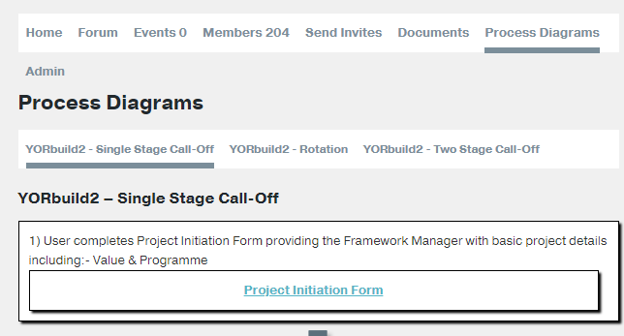
YORhub Process flowcharts
Notes:
FA

Slide 16
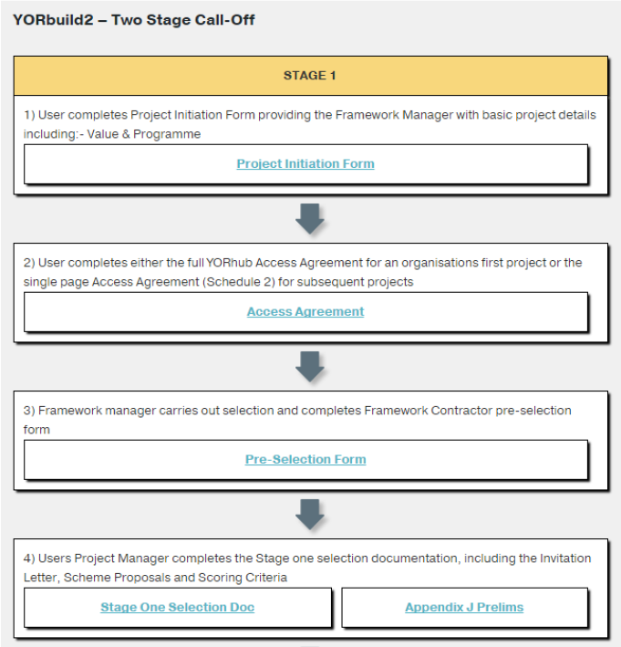
Two stage mini comp - flowchart extract
3 different flowcharts exist on yorhub.net site
Direct selection (rotation)
Single stage
Two stage
Hyperlinks to templates/ spreadsheets
Stage 1 template useful – see opposite
Notes:
FA

Slide 17
Pros and cons
Notes:
CB

Slide 18
Key requirements
Time
+Risk
+BIM
Cost
Quality
Notes:
CB
These are the same requirements that we always see.
But, addded in BIM as this is now an increasing theme in tenders for construction projects.

Slide 19
Pros - cost
Single stage | 2 Stage
Competitive tension usually gives better prices | Can match tendered prices and better them with positive engagement from all parties
Straightforward process | Prices are negotiated, giving greater flexibility
Is standard industry practise and is well understood | Benefits from contractor and supply chain input. Option of partnering further down the supply chain
Alternative offers can be invited (but can be difficult to evaluate) | Full transparency of pricing
 | If the contractors profit is secured there should be more focus on delivering a successful project
 | If cost planning is adopted during the negotiation there is the ability to manage budget pressures
 | Potential to harvest VE ideas from stage 1 bidders
 | Greater ability to influence selection of supply chain
 | Should lead to fewer post contract changes
Notes:
Just read from slide.
CB to do single stage.

Slide 20
Cons - cost
Single stage | 2 Stage
Messy to negotiate post tender when the budget is exceeded | Contractors can get greedy – clever estimators over measure rates or exploit plugged rates.
Minimal input from tenderers and their supply chains may be costing the client more if the design is over specified or over designed | Items where the Contractor would normally accept the risk get added to the price e.g. site security
Lack of transparency of pricing | If the contract is awarded on a target cost basis access to and understanding of actual costs can be difficult
Race to the bottom | Relies of positive engagement from all parties to work effectively – needs careful team selection
Lacks price certainty until tenders are returned | It can be difficult to challenge the cost of in house trades (YORhub requires a business case to address this)
D&B not popular with tenderers, seen as too risky
Notes:
CB to do 2 stage cons.
Main negative is contractors see 2 stage as an opportunity to negotiate to push the cost higher.
There is often a lack of transparency and low numbers of sub-contract tender returns leading to a lack of competition.

Slide 21
Pros and cons - time
Single stage | 2 Stage
Is a quick and relatively straightforward process | As the Contractor can be involved much earlier there is the potential to save time
Tenderers are often given insufficient time to tender and either price in risk or gamble, resulting in higher prices or prices lower than they should be | Negotiations are time consuming and can be difficult to manage – and can drag on if a programme isn’t developed and followed
Tenders often withdraw due to unrealistic deadlines | Tenderers can prioritise single stage projects, leading to delays
The contract period is often dictated by the design team without input from contractors and may not be feasible or could be over generous | Realistic programmes can be agreed.
 | Some Contractors have good access to off site solutions, saving on site build time
 | Enabling contracts are easier to arrange and can minimise time on site.
Notes:
By the time the high price comes in the Client is usually up against time to start on site, or perhaps lose funding, and so is forced to accept a poor value tender.

Slide 22
Pros and cons - quality
Single stage | 2 Stage
On a client designed projects the quality is largely dictated by the clients design team. Increasingly tenderers seem to be taking advantage of the ‘equal approved’ option and proposing alternatives | The 2 stage process enables joint decisions to be made on product and system selection with the potential to benefit the project
On D&B projects with output specifications there is limited time to fully assess the different products or systems proposed by tenderers | Similar to the above there is generaly more time to assess the products or systems.
Notes:
CB to do single stage

Slide 23
Pros and cons - risk
Single stage | 2 Stage
The quality of tender documents* is variable and sub-standard documents expose the client to risk | A collaborative process should ensure that issues with the design or spec. are identified and resolved
Contractors are given minimal lead in times and this can cause problems | On negotiated projects the contractor hits the ground running as they’ve had time to carefully plan project delivery
 | Should lead to fewer post contract changes
 | Contractors can try and take advantage by transferring more risk over to the client
*Note - YORhub has produced a note of what a good tender looks like, with input from YORbuild contractors)
Notes:
I’ve already alluded to the main risk and that is that a price cannot be agreed in 2 stage and you have to start again or revert to single stage.

Slide 24
BIM
Single stage | 2 Stage
It is difficult to obtain full BIM benefits on a single stage tender | A 2 stage process enables the full benefits of BIM to be exploited, benefiting time, cost, quality and minimising risks
Notes:
BIM can be achieved if you go out to tender early enough on an early design (say RIBA stage 2 or 3).
That allows the contractor to use BIM from stage 3 onwards.

Slide 25
Summary
Notes:
CB

Slide 26
Summary
Single stage | 2 Stage
Single stage tendering remains the preferred approach within the public sector, despite its many drawbacks | Witnessing or participating in a well run negotiation where all parties are fully engaged is a delight
There is still a place for single stage tendering but this is more suited to low value, low risk projects | Witnessing or participating in a poorly run negotiation where parties are at odds is a missed opportunity and does this option a disservice
The failure of Carillion is partly attributed to rock bottom margins and high levels of risk being accepted on public sector tenders won in competition – ‘race to the bottom’. | Contractors who abuse the 2 stage process by trying to maximise their return also do this option a disservice
 | Many clients have had a negative experience of negotiated projects for the reasons mentioned above
 | YORhub has robust processes in place to ensure that the full benefits of collaboration including value for money can be obtained
 | BIM benefits can be fully exploited using the 2 stage approach
Notes:
CB to do single stage from slide

Slide 27
Tender procedure choice
So which procedure would you choose?:
Time – which procedure is more likely to ensure the project starts on time
Cost – which procedure will give better value
Quality – which procedure will give me a better product
Risk – which procedure is better at dealing with risk
Both can be used on the YORbuild2 framework.
Notes:
CB

Slide 28
Q&A/ Close

