Slide 1
High Needs Capital
EBDOG workshop: 7 June 2019

Slide 2
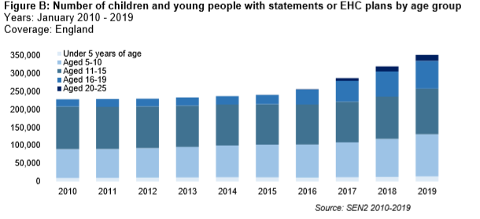
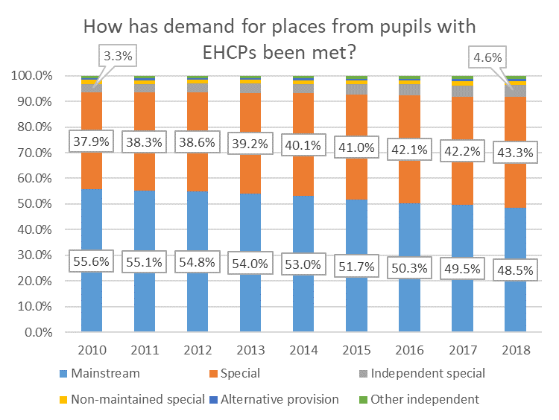
Context: an increase in children with EHCPs, and increasing reliance on specialist and independent settings
Increase in EHCP volumes driven by demographic growth, and increasing EHCP rates
11% increase between January 2018 and 2019
Increases more pronounced at post-16 level and for primary age children
Compounding effect as demographic bulge moves through the system
Increased demand on the High Needs budget, driven by:
Demographic growth
Increasing EHCP rates
Drift towards more specialist provision

Slide 3
The capital story so far: capital direct to LAs + special and AP free schools
Capital funding allocations to LAs increased from £215m to £365m, 2018-21
Ramped up delivery of special and AP free schools:
Opening AP and special free schools has shown that the commitment from local authorities is important so that the new schools complement the local education offer and are a close match for what families need.
Changes to the process for opening new special and AP schools to allow local authorities to set out their case for why a new special or AP free school would benefit their area.
In March, we approved 39 bids from LA bids to establish new schools through this route
This approach enables us to establish new schools that fit within local authorities’ strategies and are therefore effective, cost efficient and best meet the needs of children.
Type | Open (2011-now) | Pipeline (expected to open by 2023)
Special free schools | 34 | 91
AP free schools | 43 | 13

Slide 4
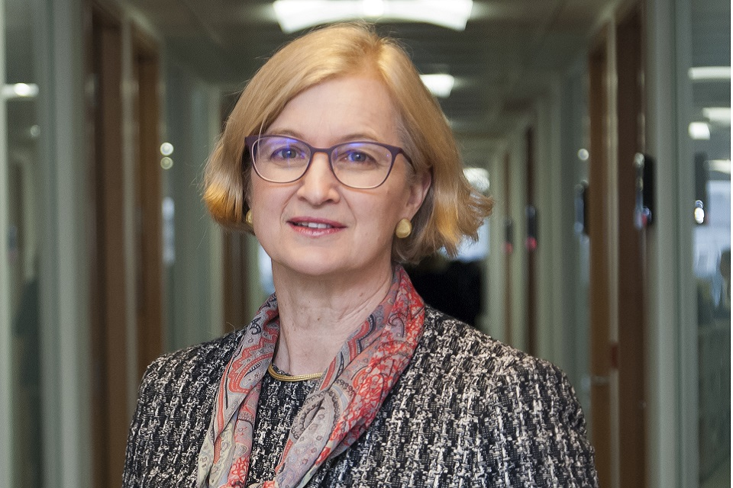
New Ofsted framework
Ofsted published its new inspection framework for early years, schools and post-16 education on 14 May alongside its response to the consultation on the framework. The consultation ran from 16 January to 5 April and received 15,000 responses.
The new arrangements include a stronger focus on the curriculum – through a new ‘quality of education’ judgement – and on reducing workload.
The new schools handbook makes clear schools should have an inclusive culture that ensures the needs of all pupils are met.
The new framework will be implemented from September 2019.
Ofsted handbook: inclusion and off-rolling
253. Schools should have an inclusive culture that supports arrangements to:
identify early those pupils who may be disadvantaged or have additional needs or barriers to learning
meet the needs of those pupils, drawing, when necessary, on more specialist support, and help those pupils to engage positively with the curriculum
ensure pupils have a positive experience of learning and achieve positive outcomes.

Slide 5
Timpson review of exclusions
Four pillars for reform
Ambitious leadership that sets high expectations for every child
Better equipped schools that have the capacity and skills to deliver
The right incentives that create the conditions to deliver for every child
Safeguards to ensure no child misses out on education
Including new guidance and training for school leaders, and clearer duties to work together with LAs and others to plan to understand and plan to meet pupil needs.
Timpson’s review is clear about the need for calm and safe environments, and is clear about the role exclusions play in creating those. It also sets out that we need to do more, around four pillars to ensure exclusion is always used well.
Including better core training for all teachers, improving the quality of alternative provision and elevating its status to in the system to deliver expert support and continue to invest in multi-agency support for schools.
Four government commitments
Support head teachers to maintain safe and orderly environments
Support schools & partners to put in place effective preventative interventions
Clarify when and how it is appropriate for children to be removed
Support schools & alternative provision (AP) settings serving excluded pupils
Including ensuring schools have a long term interest in pupils by making them accountable for the outcomes of excluded children, and ensuring governor reviews offer effective challenge and scrutiny.
Including putting in place safeguards to ensure no child slips through the net because they are off-rolled or excluded for multiple fixed periods, and taking action to prevent children becoming drawn into crime and violence

Slide 6
Forecasting demand for places in different setting types
Forecast total pupils at LA level
Start with school census
Cohort progression at LA level – based on recent trends
Forecast EHCP rates
Take actual EHCP rates from 2011/12 onwards (including pre-EHCP system)
Project forward using trends
Forecast destinations
Take current splits
Make assumptions about trends
Factor in role of capital implied in continuing and changing those trends
The main unknowns in this are:
Whether EHCP rates will continue along current projections
How the split between the different provision settings evolves
Accuracy of ONS projections of populations aged 4 for each future year

Slide 7
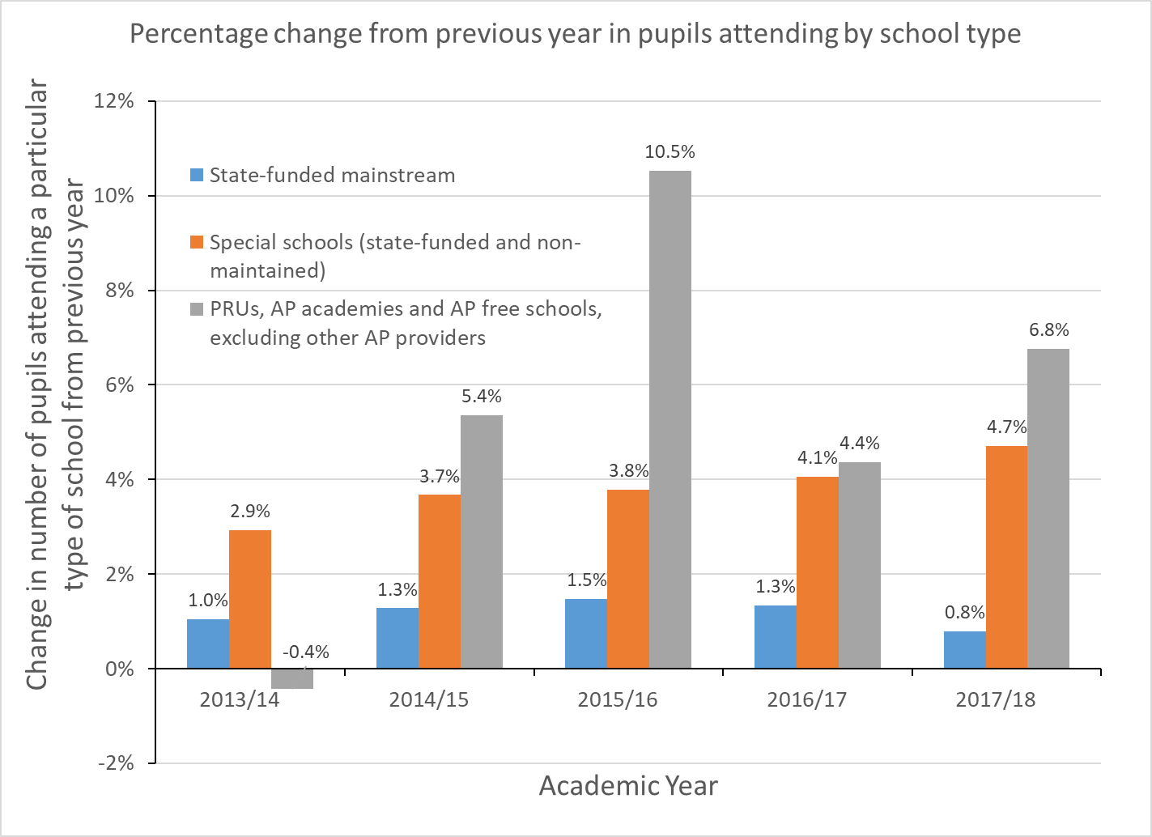
The AP pupil population
The pupil population in PRUs, AP academies, and AP free schools has been growing at a faster rate than that of mainstream and special schools.
Overall LA spending on AP has remained roughly consistent over recent years, at around 10% of the high needs budget.
The government’s response to the Timpson review committed to seek, in the next spending review, to secure capital funding for improving and expanding buildings and facilities, including for children who may require AP so that children in AP have access to high quality facilities so that they receive a curriculum on a par with mainstream.
NB: Pupil population in state-funded mainstream changed from 7,519,700 in 2013 to 7,974,695 (29% increase) in 2018, compared to PRUs, AP Academies, and AP free schools which changed from 12,950 in 2013 to 16,730 (6% increase) in 2018.
Source: https://www.gov.uk/government/collections/statistics-school-and-pupil-numbers;

Slide 8
Our known unknowns: Remodelled places, SEN places in mainstream, accessibility
Re-providing SEN places
What we did:
On behalf of the DfE, Mott MacDonald asked 11 local authorities (LAs) about specific projects from 2015-17 SCAP returns, where basic need funding had been used to ‘re-provide’ SEN places.
LAs were asked to explain why they had re-provided these places.
What we found out:
Out of 27 projects, the majority of projects were attributed either to a need to facilitate school expansions (9 projects) or a change in the type of SEN need being met (7 projects).
10 projects were also linked to needing to add better facilities to existing places.
SEN places in mainstream
What we did:
Some LAs described undertaking projects in mainstream schools without an SEN unit, which included building or re-providing places they categorised as SEN places.
LAs were asked to explain why these places were described as ‘SEN places’.
What we found out:
For 8 out of 27 projects discussed, re-provided places were categorised as ‘SEN places’ because the places were expected to be occupied by pupils with EHCPs, despite the school not having a SEN unit or resourced provision.
Accessibility
What we did:
The Equality Act 2010 sets out the legal obligations that schools, early years providers, post-16 institutions, local authorities and others have towards disabled children and young people. All schools have duties under the Equality Act 2010 towards individual disabled children and young people.
We wanted to understand how local authorities are responding, and supporting schools to respond, to these duties. By ‘accessibility works’ we refer to physical adjustments to buildings so that pupils with physical disabilities can access education provision.
What we found out:
Approaches varied between LAs, though the majority (9 out of 11) set aside a fund for accessibility works in schools – either for all schools in their area, or where they were the responsible body.
Annual funding reserved for accessibility works ranged from c. £100,000 to over £1m.
Most LAs (7 out of 11) reported that their level of investment had stayed broadly the same over the past 5 years.
Next steps:
This insight is helping us to increase our understanding of how capital funding is being used to support SEND provision and accessibility. This will feed into our ongoing policy work and evaluation.

Slide 9
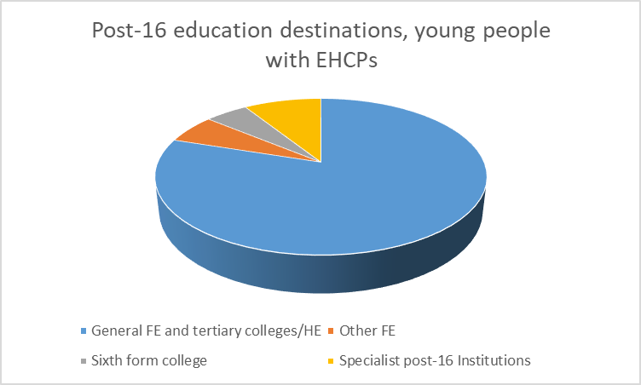
More known unknowns: post-16 places and FE
Post-16, the majority of young people with EHCPs in education, attend an FE setting. Through a limited consultation, FE colleges told us the types of spaces that post-19 pupils with SEND need include:
Flexible | Adjustable kitchen spaces | Garden space | Individual, accessible toilets
Time-out/breakout spaces | Sensory rooms | Specialist facilities | Simulated work environments
Large rooms | Discrete | Wide corridors | Disabled changing facilities.
Good IT facilities | Secure | Storage space
Durable, versatile furniture | Hearing loops/disability access | Medical spaces
Main takeaways:
All stakeholders wanted more and improved spaces.
Preparation for adulthood: general consensus that students benefit most from gaining extensive experience in the workplace.
Priorities for capital spend:
increasing the number of breakout, medical/therapy and storage spaces
investing in modular classrooms, for greater flexibility
Creating industry-standard and state-of-the-art simulated work environments.
Remodelling spaces to be larger, more secure and bespoke.

Slide 10
Feedback and discussion
Please participate in the call for evidence on funding for children with SEND and who require Alternative Provision (closes 31 July): https://consult.education.gov.uk/funding-policy-unit/funding-for-send-and-those-who-need-ap-call-for-ev/
What is your overall strategy for dealing with High Needs pressures?
What is the role of capital in that? How directly do you link the two – for example in terms of associating capital spend with revenue savings?
What could DfE do to support local authorities?
We currently provide capital allocations to local authorities, and build new special free schools through a central bidding round. What balance should we look for going forwards?
How best should we look to ensure sufficient and suitable places exist for post-16 young people?

